Slide 1

Long term management of Iron deficiency anemia in reproductive women
Dr. Afroza Jahin

Slide 2
Anemia
Anemia is defined when the hemoglobin level is reduced to the lower limit of the normal physiological range for the age and sex of the individual.
Sex | Hb level
Adult males | Hb<13 g/dL
Adult non-pregnant females | Hb<12 g/dL
Pregnant females | Hb<11 g/dL
Ref: WHO Global Anaemia estimates, 2021 Edition

Slide 3
Severity of Anemia
Severity of Anemia | Hb level for men (g/dl) | Hb level for Non-pg women (g/dl) | Hb level for pg women (g/dl)
Mild | 11-12.9 | 11-11.9 | 10-10.9
Moderate | 8-10.9 | 8-10.9 | 7-7.9
Severe | < 8.0 | <8 | <7
"Mild" is a misnomer:
Iron deficiency is already advanced by the time anaemia is detected.
The deficiency has consequences even when no anemia.
Ref:WHO. Haemoglobin concentrations for the diagnosis of anaemia and assessment of severity. Vitamin and Mineral Nutrition Information System. Geneva, World Health Organization, 2011 (WHO/NMH/NHD/MNM/11.1)

Slide 4
Iron deficiency anemia
Iron deficiency anemia develops when body stores of iron drop too low to support normal red blood cell (RBC) production.
Not all anemia in women is caused by iron deficiency, but iron deficiency is the single biggest contributor.
Globally, an estimated 50% of anemia cases are due to iron deficiency
ama-assn.orgama-assn.org

Slide 5
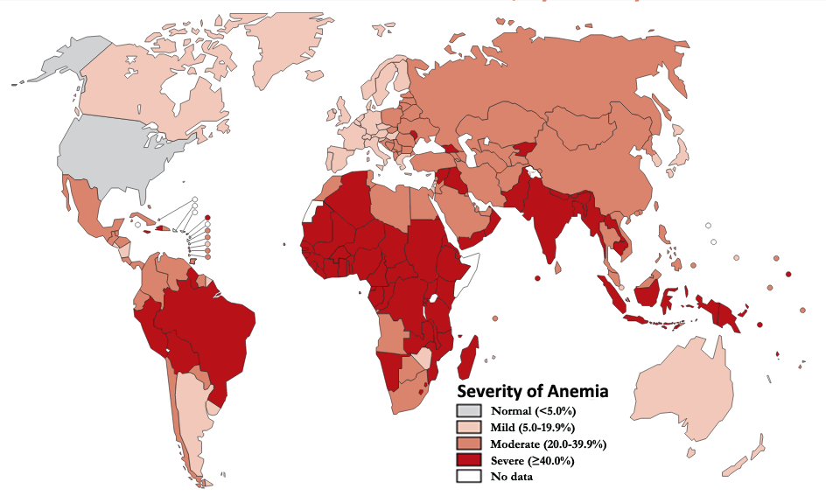
Epidemiology
1/4th
of world population is anemic.
&
½ of this burden is a result of Iron Deficiency.
Ref-1.Worldwide prevalence of anaemia, WHO Vitamin and Mineral
2. Nutrition Information System, 1993–2005

Slide 6

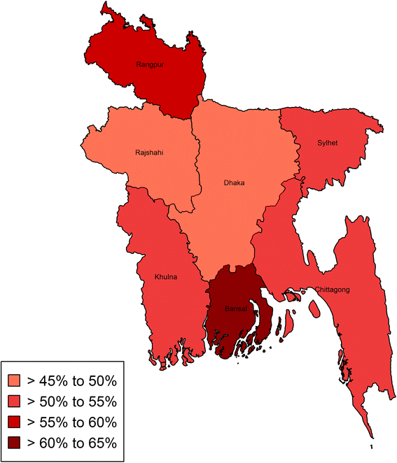
Epidemiology
In Bangladesh,
46.8% population is anemic.
36.7% women of child bearing age and 42.20% of pregnant women are suffering from iron deficiency anemia
Iron Deficiency Anemia stands for 13.6% of it
Ref: WHO Global Anaemia estimates, 2021 Edition

Slide 7
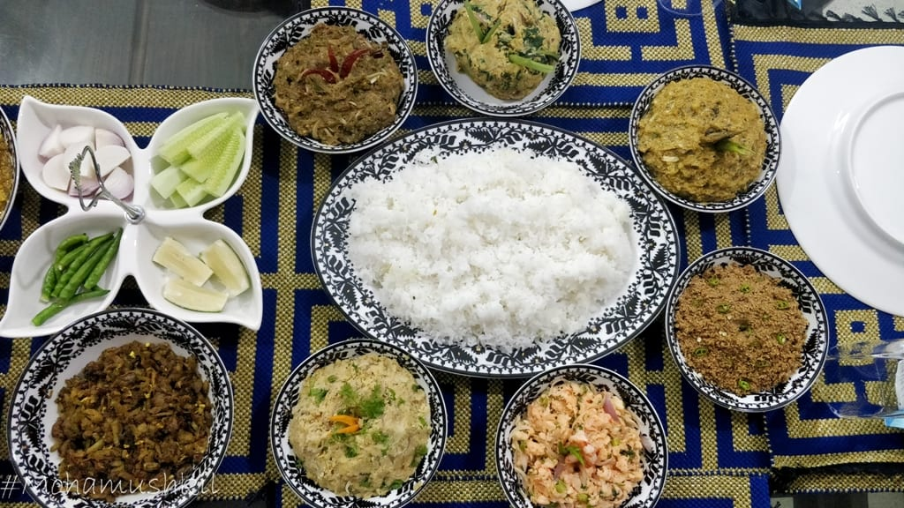
IDA in Bangladesh
Diets in Bangladesh are often heavily based on rice with low diversity in iron-rich foods, contributing to chronic inadequate iron intake.
Moreover, many women enter pregnancy already anemic or iron-deficient, which worsens maternal and neonatal outcomes.

Slide 8
IDA due to menstrual disorder
Heavy menstrual bleeding (HMB) is estimated to affect approximately 18–38% of women of reproductive age.
With an average menstrual cycle of 29 days, the average iron loss was estimated to be about 0.55 mg/day. In HMB the loss is more severe.
Women with HMB lose on average 5-6 times more iron per menstrual cycle than women with a normal blood loss.
This results in totally depleted iron stores and IDA.
A Review of Clinical Guidelines on the Management of Iron Deficiency and Iron-Deficiency Anemia in Women with Heavy Menstrual Bleeding: November 27, 2020

Slide 9
IDA in Pregnancy
During early pregnancy, body needs extra 35% iron to produce extra RBC.
40 % of Women enter pregnancy without enough iron
90% do not get enough iron during pregnancy
26% of women are iron deficit after one week of delivery
Increased fetal demand
Decreased intake
Multiparity
Low birth spacing
Early pregnancy
Hyperemesis gravidarum
Pre-pregnancy anemia
Iron Deficiency and Iron Deficiency Anemia: Implications and Impact in Pregnancy, Fetal Development, and Early Childhood Parameters,2020

Slide 10
Complications of IDA
🧠 Neurological & Cognitive
Poor memory and concentration
Irritability
Cognitive delays (especially in children)
💓 Cardiovascular
Tachycardia, palpitations
Exertional dyspnea
Heart failure in chronic/severe cases
🧒 In Children
Impaired growth and development
Learning difficulties
🤰 In Pregnancy
Low birth weight
Postpartum depression
Increased maternal mortality
🛡️ Immune System
Weakened immunity
Increased infection risk
🔴 General
Fatigue,
Weakness

Slide 11
Management of IDA in women
Iron supplementation is the first-line therapy for iron deficiency and iron-deficiency anemia.
The standard of care for confirmed IDA is to continue oral iron until blood hemoglobin normalizes and then continue for an additional 3–6 months to fully replete iron stores.
In cases of mild iron deficiency without anemia, physicians may still recommend oral iron supplementation (at a lower dose or intermittent schedule) to prevent progression to anemia and alleviate symptoms like fatigue or poor concentration.
sciencedirect.combmcpublichealth.biomedcentral.com

Slide 12
Limitations of Oral Therapy
Low absorption due to dietary inhibitors
Frequent GI side effects – nausea, constipation
Non-adherence common: ~30% stop within 2 months
Lack of monitoring reduces long-term success

Slide 13
Current Treatment Gap
Oral ferrous salts commonly used but have high GI side effects and low compliance. Many patients stop treatment early & anemia recurs without full iron repletion.
IV iron therapy requires hospital admission. Some patients doesn’t prefer IV route. Also there is small but potential risk of anaphylaxis.
As a result, over 40% of women in South Asia suffer from anemia, often due to iron deficiency.
Non-adherence to oral iron ranged from about 10% after just 2 weeks of therapy and up to 30% (one-third of patients) after 2 months

Slide 14
Unmet need in oral iron therapy
Better tolerability to support long-term adherence to therapy with improved absorption and bioavailability.
Adequate duration of therapy & structured follow-up and maintenance.
Alternative oral iron for those refusing or without access to IV iron.
Solutions for women with poor tolerance to ferrous salts or chronic anemia.

Slide 15
Solutions and Innovations
Iron formulations with fewer side effects and better bioavailability for improved adherence to treatment.
Long term iron therapy for correction of anemia and then continue for 3-6 months to replete iron stores.
Smarter dosing regimens (low dose) and Integrated care with gynecological support
Screening of iron deficiency with or without anemia and early diagnosis.
Patient Education and Support Programs

Slide 16
Strategic Recommendations
Adopt
Adopt ferric maltol for women intolerant to ferrous salts.
Use
Use as first-line therapy in women requiring long-term oral iron.
Incorporate
Incorporate flexible dosing to optimize outcomes.
Screen
Screen regularly and follow-up ferritin levels post-anemia recovery.

Slide 17
Case 1:
🩺 Case:
A 24-year-old woman presents with tiredness and hair fall. She has regular menstrual cycles. Lab: Hb 10.8 g/dL, MCV 76 fL, Ferritin 18 ng/mL.
Question:
1- Diagnosis
2- Etiology
3- Management

Slide 18
✅ Answer:
  Diagnosis: Mild Iron Deficiency Anemia (WHO: Hb 11–11.9 g/dL).
  Likely etiology: Nutritional anemia or menorrhagia.
  Management:
  Details history taking to evaluate cause.
  Dietary and menstrual counselling.
  Iron therapy for correction of anaemia with tolerable oral iron preparation.
  Continue oral iron 3–6 months post-Hb normalization for correction of iron storage.

Slide 19
Case 2:
🩺 Case:
A 45-year-old woman with ischemic heart disease presents with exertional dyspnea. Lab: Hb 8.5 g/dL, Ferritin 8 ng/mL.
Question:
1- Diagnosis
2- Etiology
3- Management

Slide 20
✅ Answer:
  Diagnosis: Moderate Iron Deficiency Anemia with possible heart failure.
  Likely etiology: Chronic blood loss, poor iron intake, reduced absorption, increased requirements or parasitic infections.
  Managemet- Goal is to replenish iron stores, correct anemia, and treat the underlying cause.
1- Iron therapy
IV Iron- Ferric carboxymaltose (preferred) or iron sucrose
Dose based on body weight and Hb%
Monitor for hypersensitivity

Slide 21
✅ Answer:
  2 - Identify and Treat the Underlying Cause
  Menorrhagia → hormonal therapy or surgical management
  GI bleeding → endoscopy, treat ulcers, stop NSAIDs
  Parasitic infection → anti-helminthics (e.g. albendazole)
  ECG & chocardiography to assess heart failure and management
3- Monitor Response
Recheck Hb, ferritin, and TSAT in 4–6 weeks
Continue oral iron 3–6 months post-Hb normalization for correction of iron storage.

Slide 22
Case 3:
🩺 Case:
A 27-year-old woman at 28 weeks of pregnancy with fatigue and dyspnea. Lab: Hb 6.5 g/dL, Ferritin 6 ng/mL, MCV 72 fL.
1- Diagnosis
2- Etiology
3- Management

Slide 23
✅ Answer:
  Diagnosis: Severe IDA
  Likely etiology: Nutritional anemia or menorrhagia.
  Management:
  1- Stabilization First
  Assess for hemodynamic instability (tachycardia, hypotension)
  Hospitalize if symptomatic
  Oxygen support if hypoxic
  2. Blood Transfusion
  (Indicated if:Hb <5 g/dL even without symptoms, Hb <6–7 g/dL with symptoms)

Slide 24
✅ Answer:
3- Iron replacement therapy
IV or oral iron for further correction of anaemia
4- Identify and treat the source of iron loss:
This could involve investigating gastrointestinal bleeding, heavy menstrual bleeding, or other conditions contributing to iron deficiency.
Addressing nutritional deficiencies by increasing iron-rich foods or supplements is crucia
5- Post-stabilization:
Recheck Hb, ferritin, and TSAT
Oral iron for 3–6 months postpartum.

Slide 25
Conclusion
Iron deficiency is preventable but under-addressed in menstruating women
Current therapy is limited by tolerability and side effects.
Long term management are needed to reduce prevalence
Empowering women and healthcare systems is key to success

Slide 26
Thank you

